Slide 1
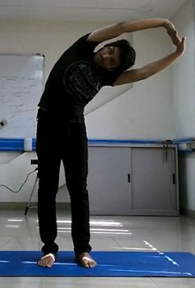
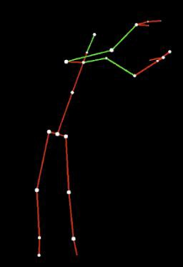
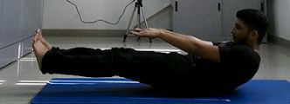
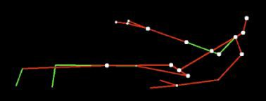
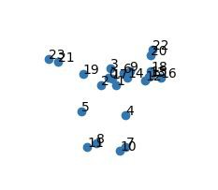
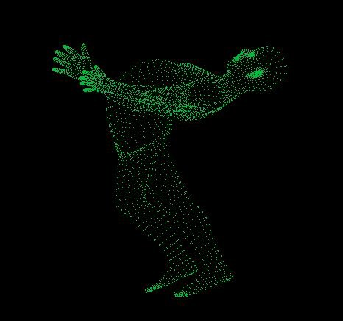
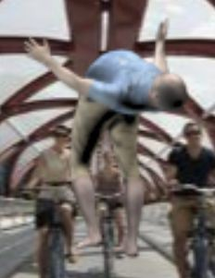
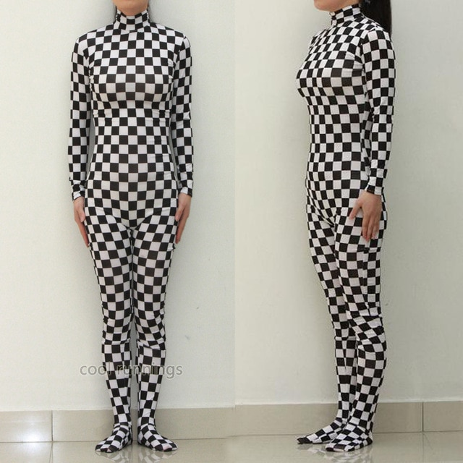
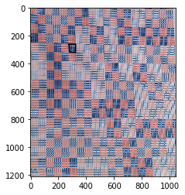
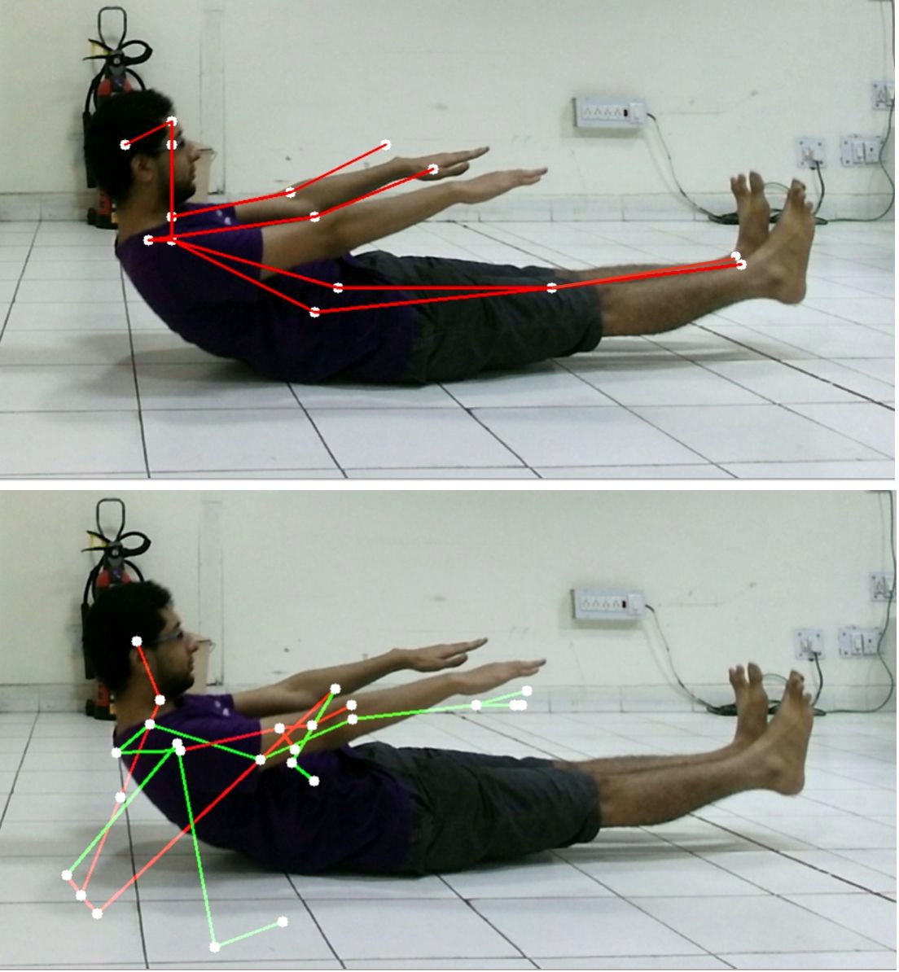
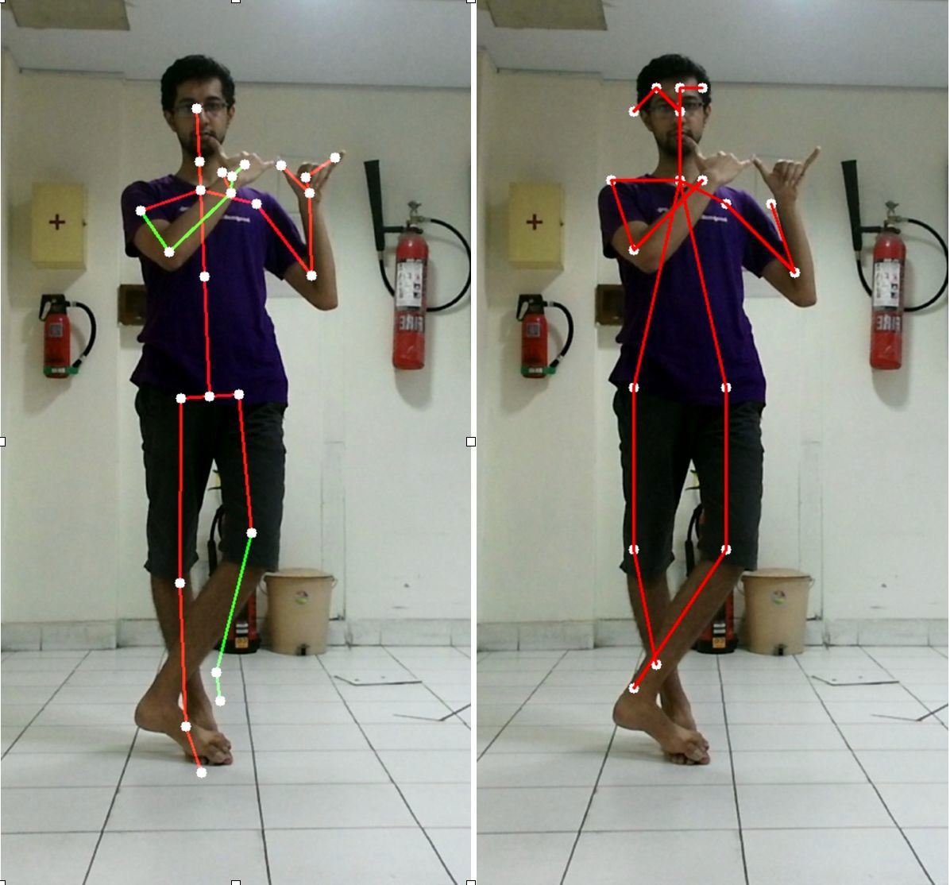
Accurate measurement of stability and relaxation in Yoga Asanas and studying its impact on Cognitive performance
Nilaksh Agarwal, Jay Paranjape, Manas and Rahul Garg
ABSTRACT
In this study, we aim to provide accurate measurement of stability and relaxation of Yoga Asanas by an individual, and later by a group, using multiple Kinect (motion sensing) and EMG (portable Electromyograph) devices.
We then aim to study its impact on Cognitive performance of these individuals by deploying the Six-letter cancellation test (SLCT) and the cognitive ability tests for adults.
ANIMATION
Inconsistent Data Labels : Posture tracking using Kinect is highly inconsistent in case of Yoga Asanas. While creating the data, correct ground truth labels for joint positions are required. To solve this issue, we create our own animations using joint positions as input.
IIT DELHI
MoCap Suit
We aim to make a novel motion capture suit which can accurately track any body point in real time.
Algo: The suit comprises of red and blue patterns following a certain order. Each cell will have different amount of intensity. Thus, a 3X3 matrix as captured by a simple high resolution camera will be sufficient to uniquely label a point.
The image on the left shows an
example of a bodysuit and the
image on the right is an example
of pattern used. As seen, each
square has a different value of color and brightness. The square at 300,300 has been detected.
Potential Applications:
This is a real time high accuracy tracking which will improve the current motion capture process. This has high applications in sports, animation industry, filming, posture studies,
recommender and selection systems. We plan to complete the complete algorithm, prepare the dress and start experiments. If successful, we will apply for a patent
Animation : Using the 3D joint positions provided to us by Kinect, We create a SMPL body model, described by part length and 3 part angles for every body part. Using these details, we can create animations of our own.
>>
>>
Consistency in Data : Now we have our own animation videos with consistent ground truth joint positions which also provide other details like RGB image (with a random background), depth image, Optical flow data etc. for a complete dataset. This data will result in a better Deep Learning model than the one trained directly on the data provided by Kinect, due to consistency in data.
FUTURE WORK
Year 1 | -- Include last year results and data collected --
Year 2 | Extending the project to tracking over 3-4 people using multiple kinect devices. By using multiple devices, we can get the 360 degree analysis of the whole group, with careful collaboration and integration between the data received by each Kinect. This will require a change in the existing algorithm being used for posture detection.
Year 3 | By using the portable EMG we can give Biofeedback for the muscle relaxation by measuring the muscle potential. By using Machine learning to indicate the correctness of the Yoga Asanas performed, including the number of repetitions involved, we can inform them about the muscle fatigue, hence better yoga technique.
Year 4 | Integrating the portable EMG device with the Kinect based device and hence having a complete yoga module, which would be used for the study of cognitive performance of the individuals. The module would be used for measurement of the correctness and perfect posture through which study on the cognitive performance parameters can be done.
POSTURE TRACKING
Failure of Kinect : Tracking of Yoga asanas can be challenging due to unusual body extensions and high amount of self-occlusion involved. Kinect SDK fails in such cases. We have worked on the idea of integrating both RGB and Depth images as inputs to our model, obtaining significantly better results.
COMPUTER SCIENCE AND ENGINEERING
<< Our model (top) vs Kinect (bottom)
REFERENCES
J. Shotton, A. Fitzgibbon, M. Cook, T. Sharp, M. Finocchio, R. Moore, A. Kipman, A. Blake, Real-time human pose recognition in parts from single depth images, 2011
Varol, G., Romero, J., Martin, X., Mahmood, N., Black, M. J., Laptev, I., & Schmid, C., Learning from synthetic humans, 2017
Bogo, F., Kanazawa, A., Lassner, C., Gehler, P., Romero, J., & Black, M. J., Keep
it SMPL: Automatic estimation of 3D human pose and shape from a single image, 2016
Martinez, J., Hossain, R., Romero, J., & Little, J. J., A simple yet effective
baseline for 3d human pose estimation, 2017
Our model (right) >> vs Kinect (left)
Results on SURREAL Dataset : Performance of Our model vs
state-of-the-art Martinez et. al. for both 2D and 3D joint detection.
 | 2D joint detection (Average Precision) |  |  | 3D joint detection (Mean Error)
 | AP | _{AP}50 | _{AP}75 | MPJPE
Martinez et. al. | 59.1% | 77.7% | 61.2% | 82.3 mm
Our Model | 65.1% | 81.7% | 66.5% | 72.9 mm
For further queries, Contact:

